Slide 1
Rivers for Future Generations How Do We Transform Our Rivers?
Bill Dennison
27 May 2020

Slide 2
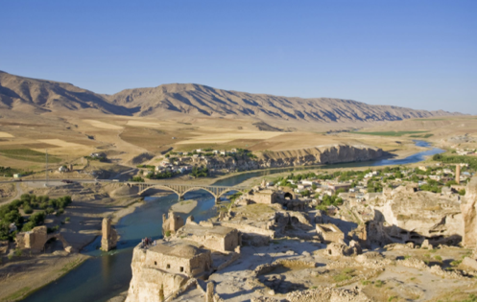
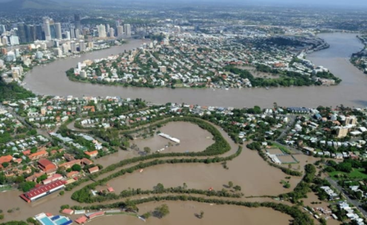
Resilient Rivers Blueprint
Rivers = lifeblood of civilizations
Communities form intimate relationships with rivers
BUT
Relationships between rivers and communities changing rapidly
Developing resilience to disturbances is a priority

Slide 3
We created the Resilient Rivers Blueprint to develop new ways of managing rivers

Slide 4
What is river resilience?
River resilience = The capacity of a river system and its associated communities to quickly recover from disturbances, adapt to changes without collapsing, and to transform through innovation and implementation of resilience strategies.

Slide 5
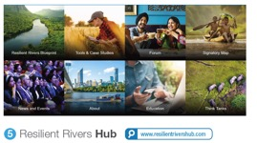
5 step process to develop river resilience

Slide 6
First step: Self-assessment

Slide 7
River Journey in 10 stages

Slide 8
Origination phase: Connectedness

Slide 9
Exploitation phase: Conveyance

Slide 10
Exploitation phase: Commerce

Slide 11
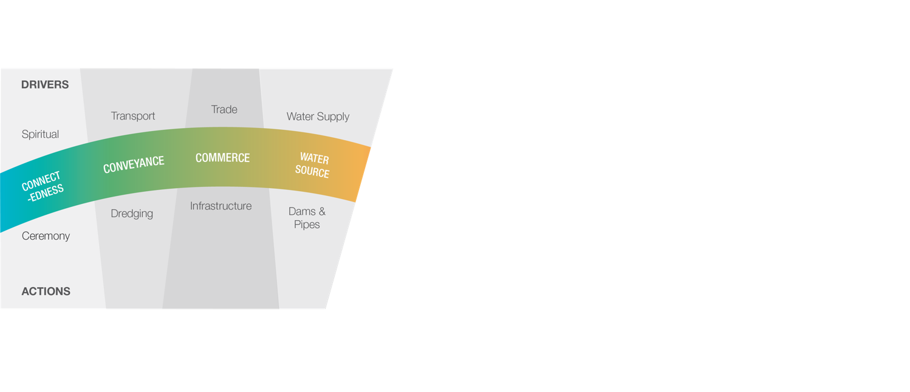
Exploitation phase: Water source

Slide 12
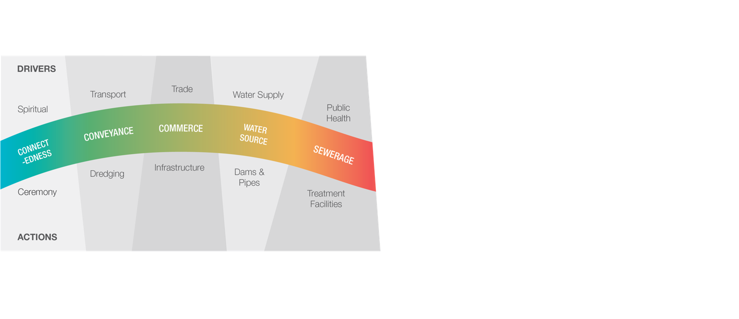
Mitigation phase: Sewerage

Slide 13
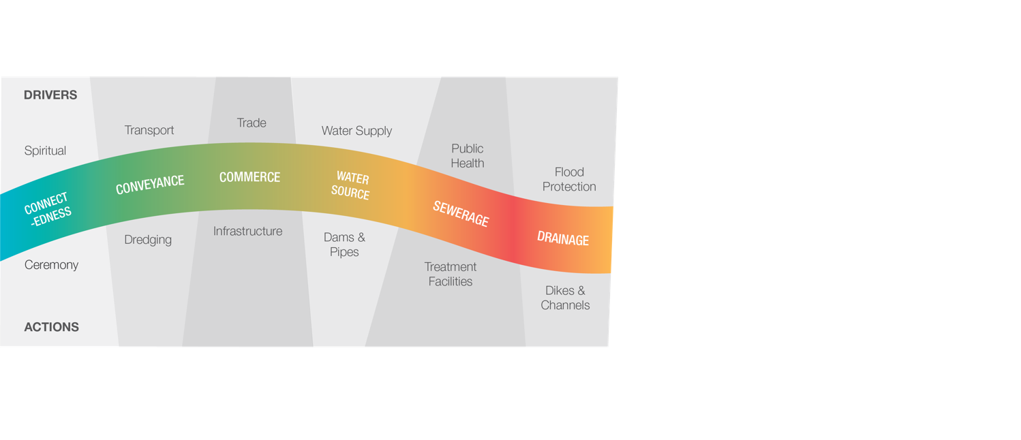
Mitigation phase: Drainage

Slide 14
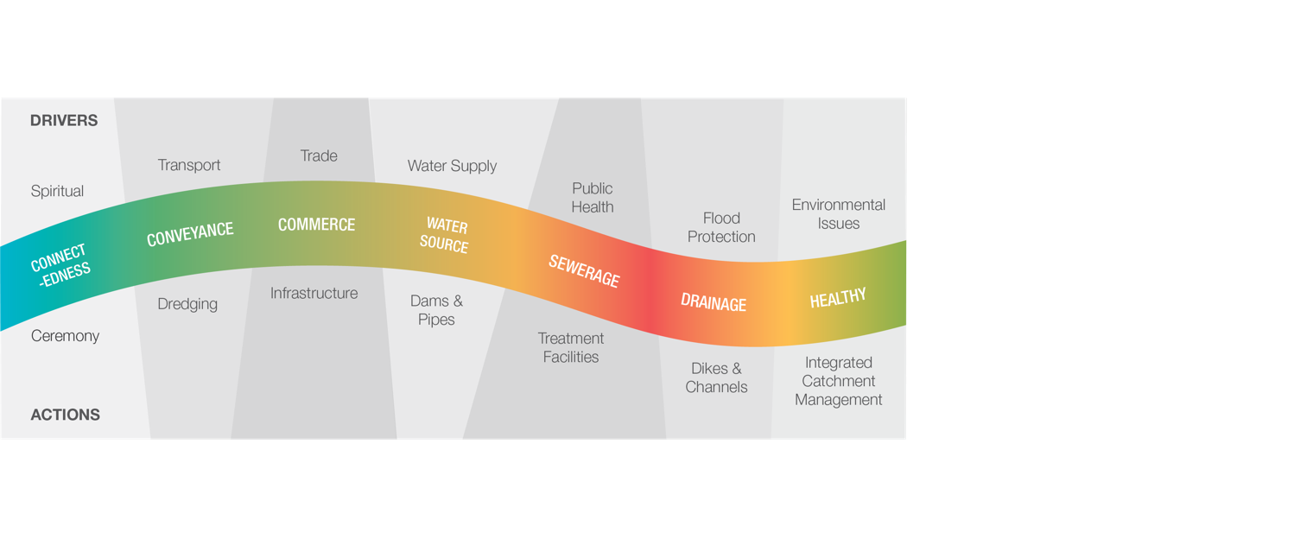
Mitigation phase: Healthy

Slide 15
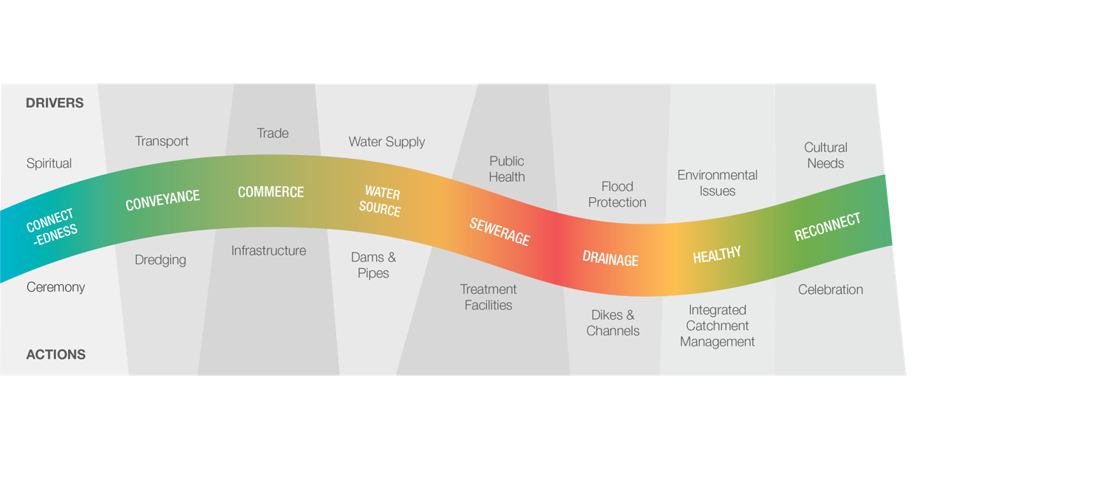
Reconciliation phase: Reconnect

Slide 16
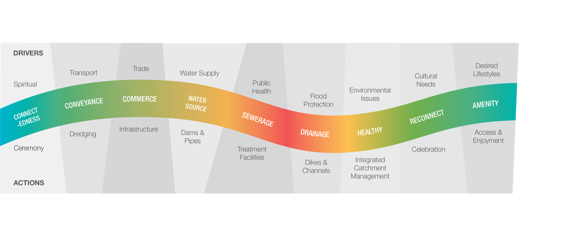
Reconciliation phase: Amenity

Slide 17
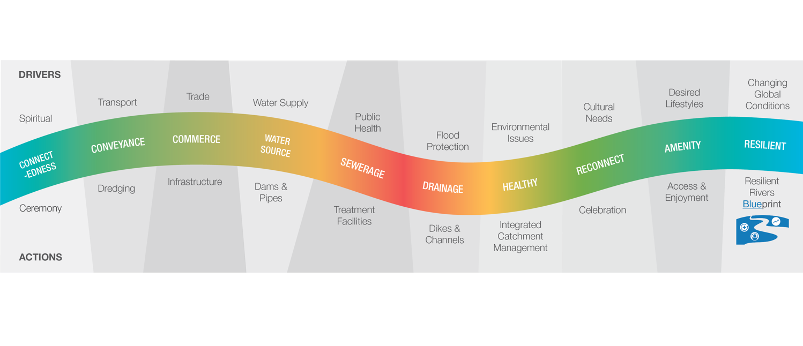
Transfomation phase: Resilient

Slide 18
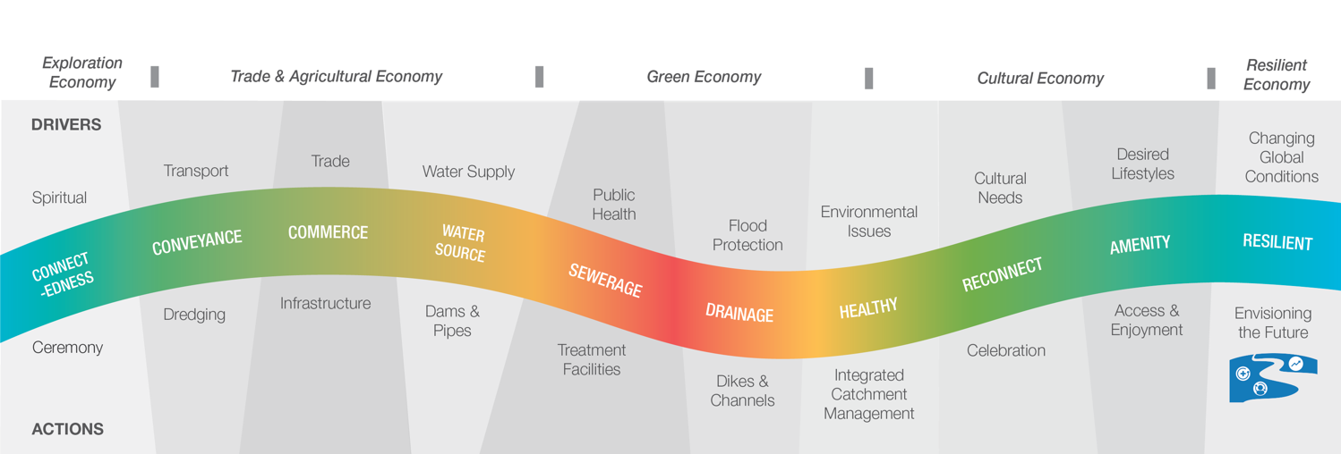
Exploration economy

Slide 19
Trade & Agricultural economy

Slide 20
Green economy

Slide 21
Cultural economy

Slide 22
Resilience economy

Slide 23
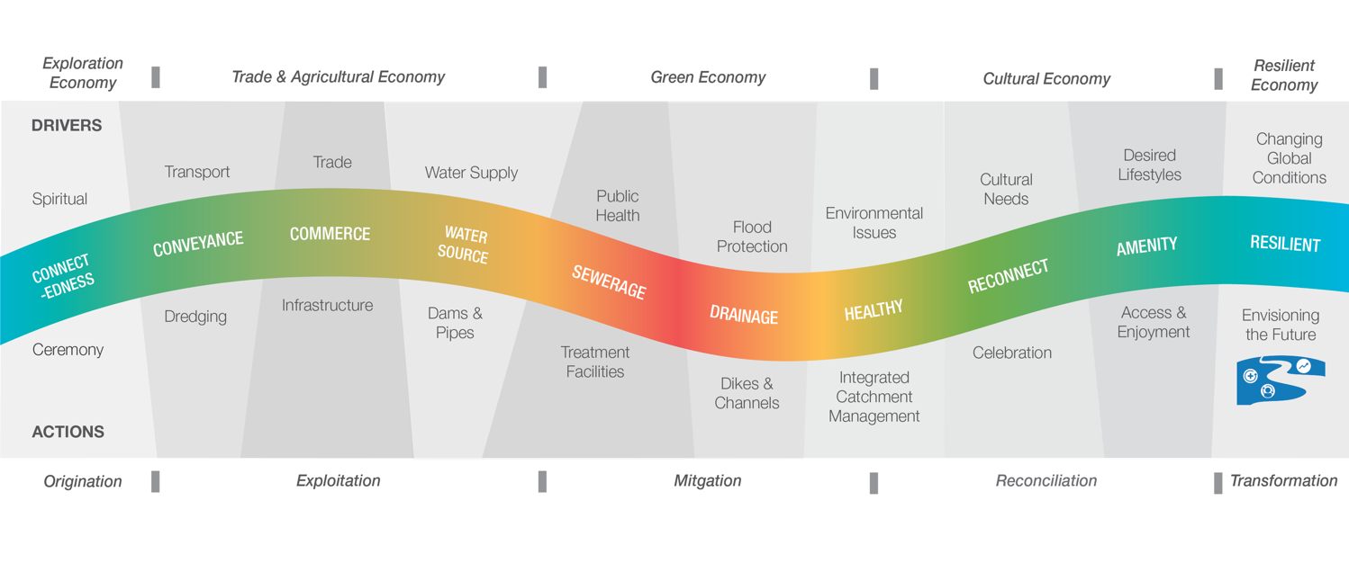
Resilient River Journey

Slide 24
Resilient River Journey – Brisbane River example
1850s
1860s
1950s
1960s
1970s
1990s
2000s
2010s
Pre-1820s

Slide 25
First step: Self-assessment

Slide 26
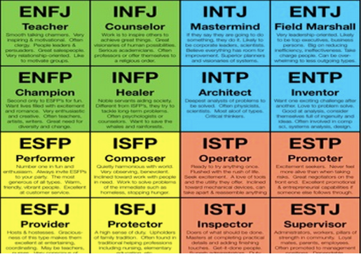
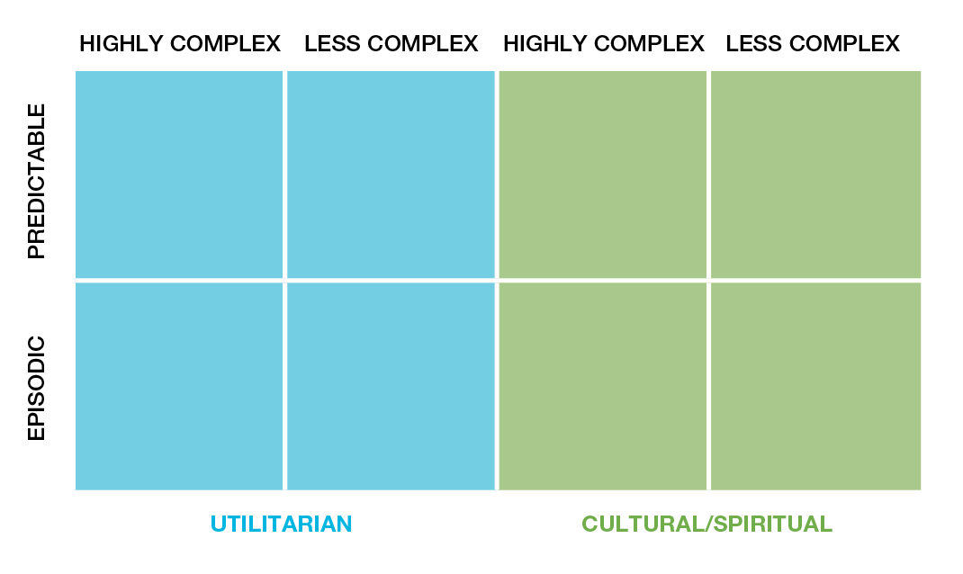
Human personalities River personalities
Extravert vs. Introvert
Sensing vs. INtuition
Thinking vs. Feeling
Judgement vs. Perception
Less Complex vs. Highly Complex
Utilitarian vs. Cultural/Spiritual
Predictable vs. Episodic

Slide 27
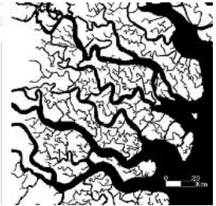
Less complex vs. Highly complex
Size
Watershed/catchment/basin area
Stream order
Governance arrangements
Single government vs. Transboundary
Issues
Diversity of issues
Intensity of issues
Actors/institutions
Diversity of actors & institutions
Competing factions

Slide 28
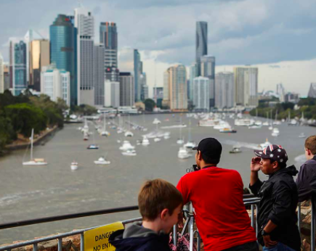
Human Engagement
Utilitarian
H₂O Source
Sewage disposal
Flood protection
Port development
Cultural/Spiritual
Amenity/lifestyle
Healthy/Water quality
Spiritual/Connectedness

Slide 29
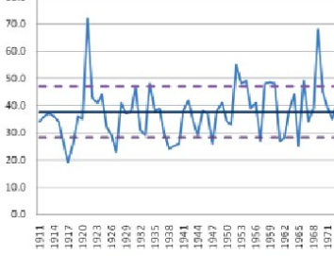
Predictable flows vs. Episodic flows
Predictable
Dam releases
Monsoonal seasonality
Snowpack melt
Episodic
Highly variable flows
Ephemeral flows

Slide 30
River Personality matrix

Slide 31
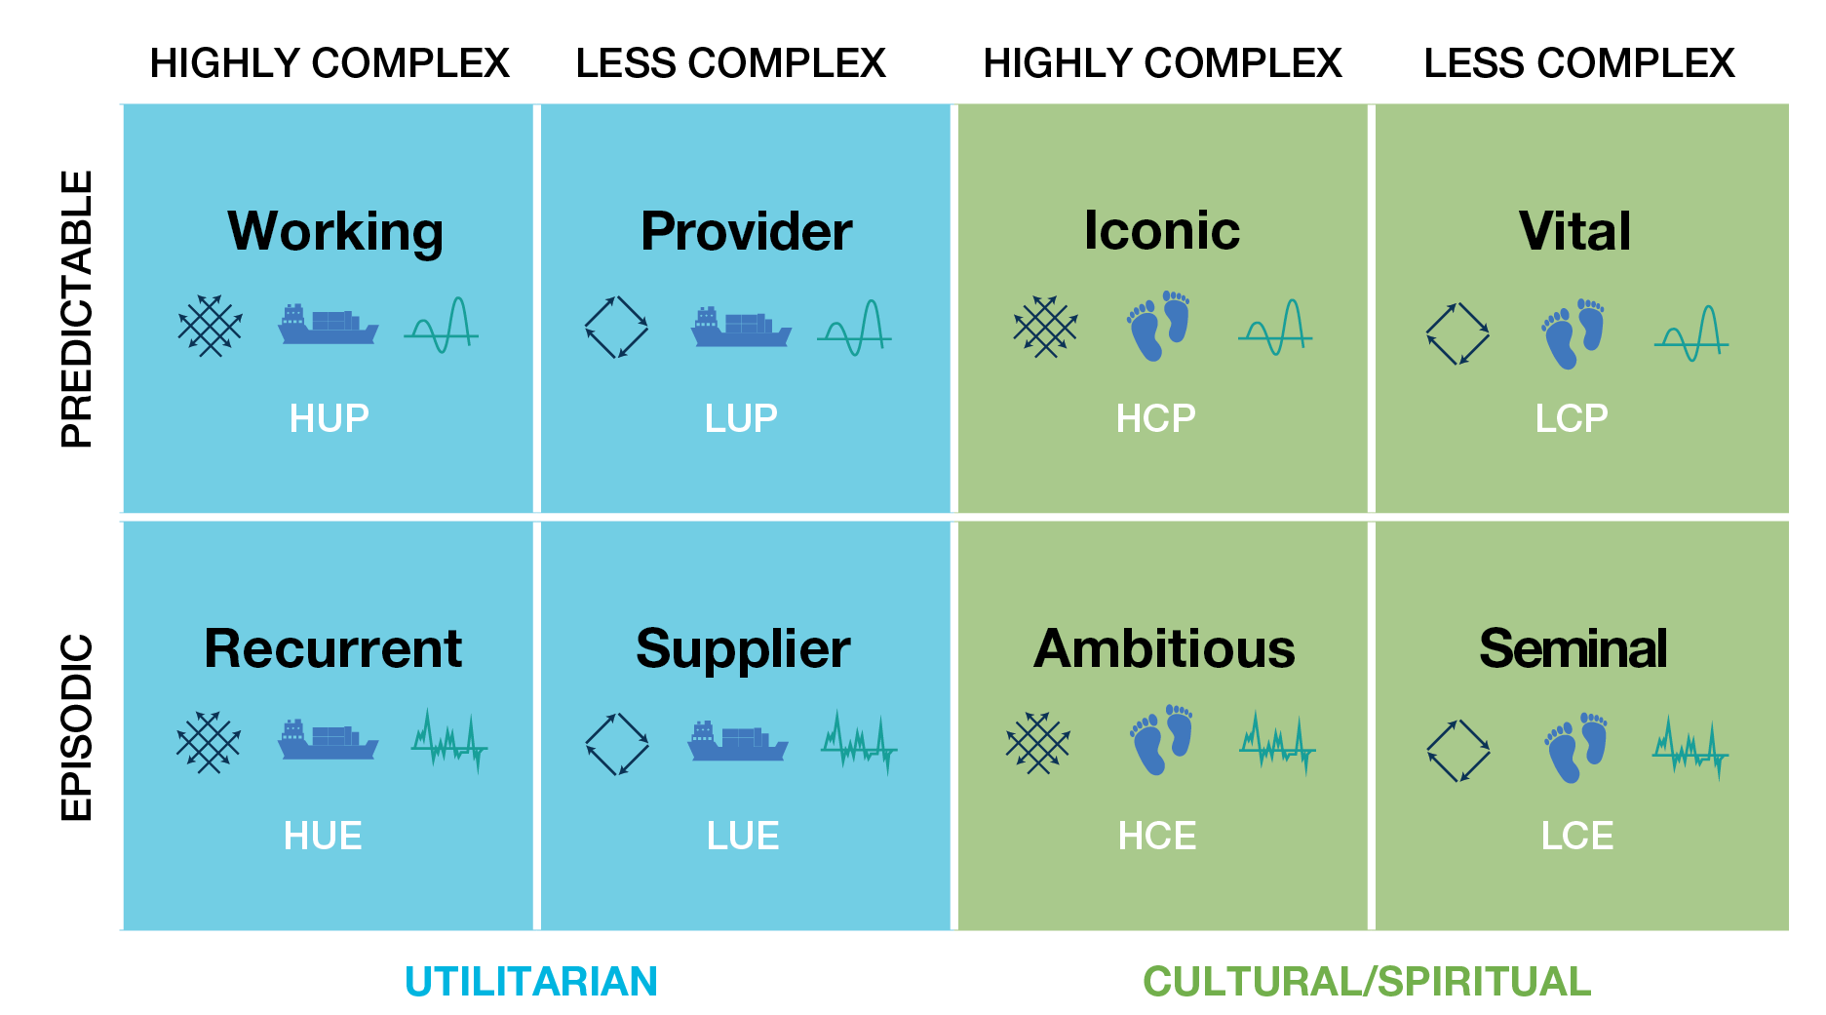
Working river: Highly complex, utilitarian, predictable

Slide 32
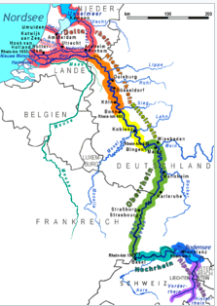
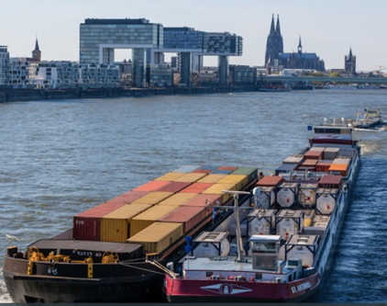
Working river: Highly complex, utilitarian, predictable
Rhine River
1,230 km long
Transboundary
Diversity of issues
Competing uses
Major shipping/ports
2014 Thiess International Riverprize winner

Slide 33
Provider river: Less complex, utilitarian, predictable

Slide 34
Recurrent river: Highly complex, utilitarian, episodic

Slide 35
Supplier river: Less complex, utilitarian, episodic

Slide 36
Iconic river: Highly complex, cultural, predictable

Slide 37
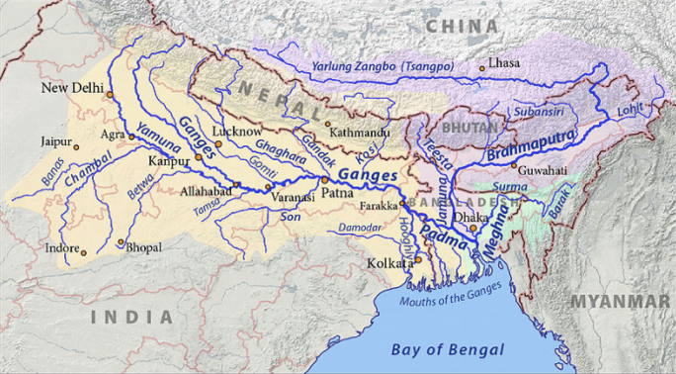
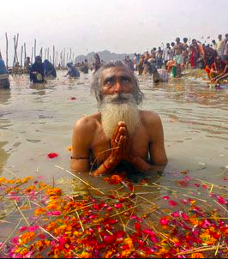
Iconic river: Highly complex, cultural, predictable
Ganges River
2,600 km long
Transboundary
Culturally significant
Predictable flows from Himalyas

Slide 38
Vital river: Less complex, cultural, predictable

Slide 39
Ambitious river: Highly complex, cultural, episodic

Slide 40
Seminal river: Less complex, cultural, episodic

Slide 41
Second step: Resilience assessment (report card)

Slide 42
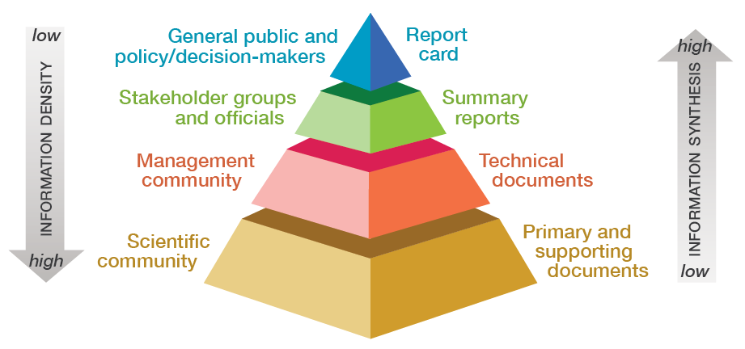
Report cards create environmental intelligence

Slide 43
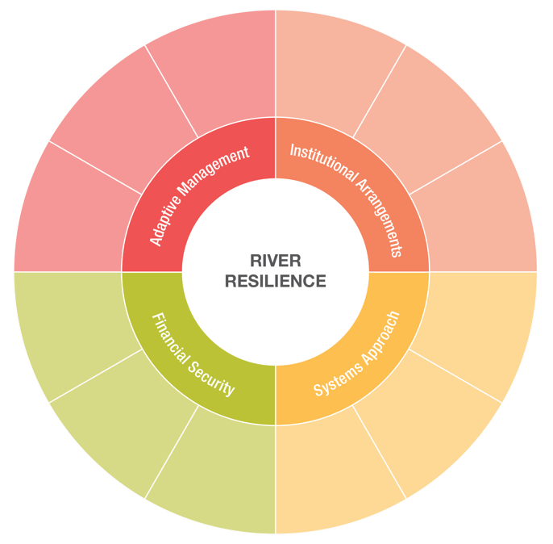
River Resilience report card goals
Institutional Arrangements
Systems Approach
Financial Security
Adaptive Management

Slide 44
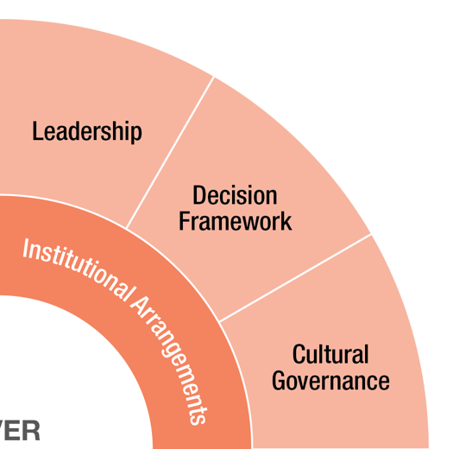
Institutional Arrangements objectives
Leadership
Decision Framework
Cultural Governance

Slide 45
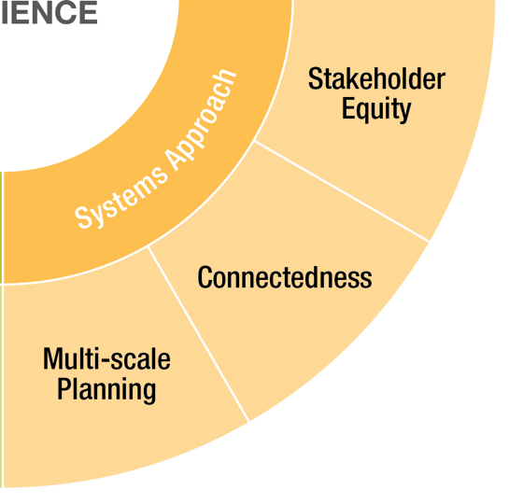
Systems Approach objectives
Stakeholder Equity
Connectedness
Multi-scale Planning

Slide 46
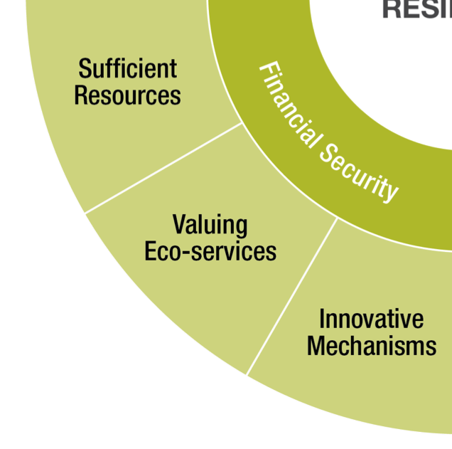
Financial Security objectives
Innovative Mechanisms
Valuing Eco-services
Sufficient Resources

Slide 47
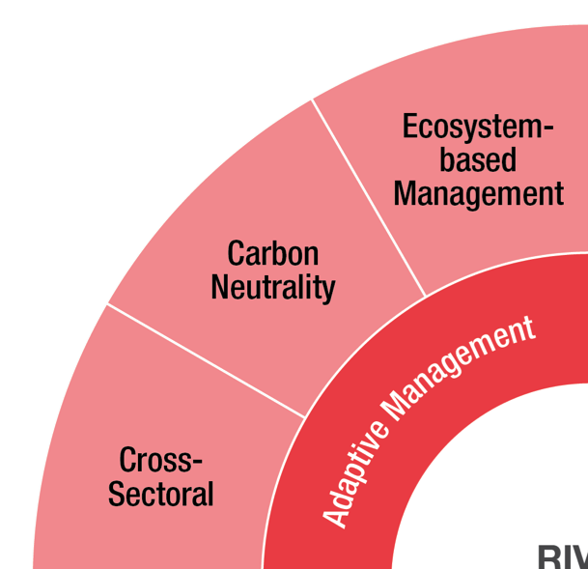
Adaptive Management objectives
Cross-Sectoral
Carbon Neutrality
Ecosystem-based Management

Slide 48
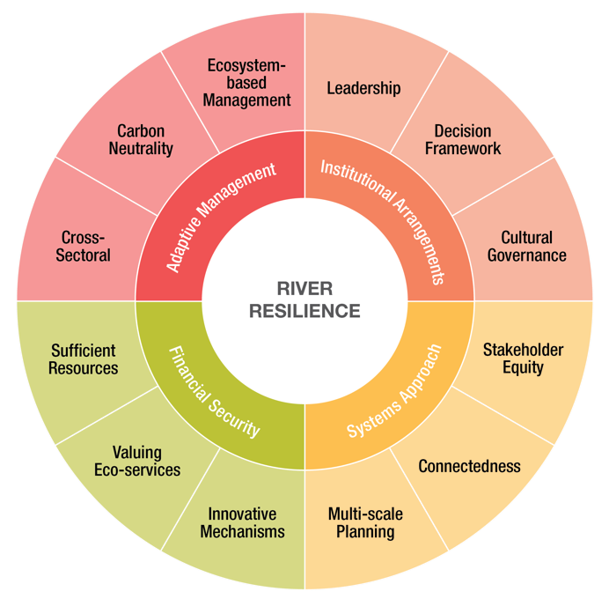
River Resilience report card goals & objectives
Locally relevant indicators for each objective selected for individual rivers
Real value is repeated measures to observe changes

Slide 49
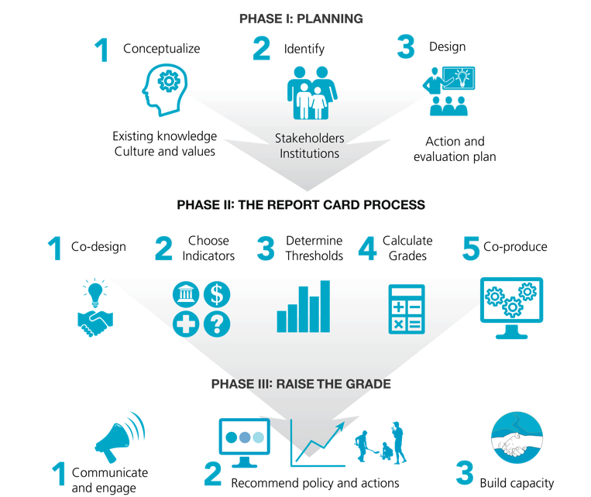
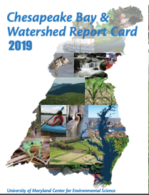
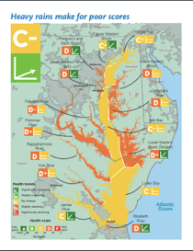
Three phase report card process
Step 1: Self-assessment
Step 2: River resilience report card
Vanessa Vargas-Nguyen 2020
Steps 3-5

Slide 50
Third step: Resilience strategy

Slide 51
Develop strategy to increase resilience attributes
Ability to withstand perturbations
Combining social, economic & environmental aspects
Ability to modify and adapt to new conditions
Broad engagement with diverse stakeholders
Existing systems that can replace functions of missing systems

Slide 52
Forth step: Action plan

Slide 53
Action Plan approach
Review river resilience report card scores for the 4 goals/12 objectives
Identify which scores need improvement
Integrate with strategy for enhancing river resilience attributes

Slide 54
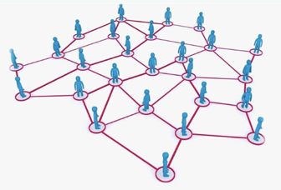
Action Plan approach
Use social network analysis to identify key stakeholders
Identify river champions to take on leadership roles
Build on existing plans
Develop actions that are a) practical, b) cost effective and c) long range in terms of perspective

Slide 55
Fifth step: Communication & implementation

Slide 56
Resilient Rivers Hub

Slide 57
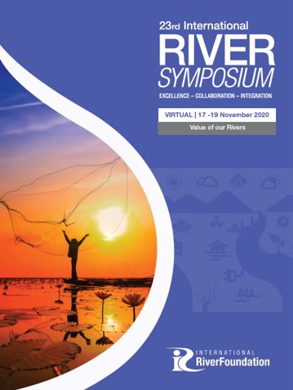
Continued development of Resilient Rivers Blueprint
Test self-assessment surveys
Assess river resilience case studies
Develop RiverAcademy course in River Resilience
Lead river resilience session in 2020 RiverSymposium

Slide 58
Work With Us
Learn more watch our videos, read our material,
listen to our podcasts
Join up sign the resilience pledge, assess and share your river journey & river personality
Assess resilience develop your river resilience report card
Build resilience create a river resilience action plan to enhance resilience attributes
Share knowledge engage with the resilient rivers hub, view resilience stories of other communities and add your story

Slide 59
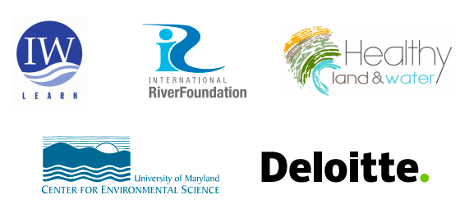
Acknowledgements
Independent Science Members
Vladimir Mamaev United Nations Development Programme
John Matthews Alliance for Global Water Adaptation
Paul Maxwell Alluvium
QingHong Pu Australia Department of Agriculture, Water & Environment
Niels Vlaanderen Netherlands Ministry of Infrastructure and Water
Ivan Zavadsky International Commission for the Protection of the Danube River
Peter Goodwin, Simon Costanzo University of Maryland Center for Environmental Science
Eva Abal, Paul Greenfield, Jacqueline Atique, Sylvia Liu International RiverFoundation
Chi Mun Woo Deloitte
Julie McLellan, Andrew O’Neill Healthy Land and Water
Natalie Degger, Mish Hamid Global Environment Facility IW:LEARN

